Slide 1
MINECOFIN Quarterly Macro-Fiscal Model (QMFM)
Quarterly Macro-Fiscal Outlook (QMFO)
Summary Outlook 2024-27
Nov 2024 Round

Slide 2
Outline/contents
Rationale of Outlook and underlying model
Recent macroeconomic developments
Initial conditions and assumptions for forecast
Macroeconomic forecast/outlook
Forecast evaluation (forecast comparison and effect recalibration)
QMFM interrelation with macro toolbox (nowcasting, intMF)

Slide 3
Acronyms
FPAS: Forecasting and Policy Analysis System (FPAS)
ER: Exchange Rate
RER: Real Exchange Rate
IB: Interbank interest rate
RIR: Real Interest Rate
NTF: Neal Term Forecast
MT and LT: Medium-Term Long-Term
YoY, %: Year on Year Percentage Change
G&S: goods and services (govt demand, exports, …)
WEO: World Economic Outlook (by IMF)
GAS: General Assumptions (in WEO)
GEE: General Economic Environment (in WEO)
CBO: Central Budget Office US

Slide 4
Glossary of key terms
Output gap & final demand gaps (+/-): output Y above/below potential or trend level Y*, i.e., output gap is log(Y/Y*) >< 0
Real interest & real exchange rate gaps: RIR and RER above/below neutral or equilibrium levels
Decomposition of macro aggregates by main drivers: coloured bars in charts show contribution of each
Fiscal deficit relevant for demand impact: deficit before grants = total expenditure -/- non/tax revenue
Debt anchor & sustainable deficit: debt ratio to GDP target (with LT growth, inflation rates, etc.) drives sustainable debt-creating deficit.
Fiscal stance expansionary/contractionary: deficit, govt demand G&S in % GDP above/below trend levels (“discretionary” deficit, demand ><0)
Fiscal impulse (on private demand): mainly discretionary fiscal deficit affecting consumption & investment (via income, ‘optimism’)
More/less restrictive monetary policies: (real) interest rates above/below neutral or trend levels
More/less restrictive exchange rate policies: real exchange rate below/above equilibrium or trend level
Role expectations: agents today consider expected macro variables and policies in future (expected inflation, exchange rate, demand gaps,…)
Forward-looking: one or four periods ahead behavioural expectations/speculations {+1} or {+4 Q}
Persistence: lag or effect of previous/initial values or behaviours
Trend (unobserved): trends of key macro variables are estimated; set steady state trends (to which variables converge in absence of shocks)
Shock: All other factors not captured by model equation or parameter specification
Decomposition (level, growth rate, % GDP): e.g., output (gap) by final demands, GDP growth by components, deficit % of GDP by revenue, exp.
Overvaluation and undervaluation

Slide 5
I. Rationale of outlook & underlying QMFM model
Regular forecasts 16 quarters ahead for key macro aggregates (i.e., output, inflation, final demands, ..) as influenced by fiscal, monetary, and exchange rate policies, incl. in response to shocks and new developments (scenario simulations)
Emphasis on fiscal and financing/debt policies and interaction with monetary and exchange rate policies, facilitating policy coordination between MINECOFIN and NBR
Input for validated macro-fiscal projections in intMF, underpinning MT budgets and IMF programs (checks on intMF)
Underlying macro model is New-Keynesian, ‘semi-structural, gap model, FPAS-type
Uses analysis of past observations and estimated trends to fit model to data; assesses initial condition for forecast
Forecast premises: policy stance (fiscal deficit path, current policy interest rate, and ER), assumptions on external environment, other exogenous, and near-term forecasts for GDP and CPI, depending on other tools and judgment
After shocks and policy responses have worked out, variables return gradually to their trends (long-term growth path), determined by their steady-state levels (outside model, e.g., potential output growth, equilibrium RER, RIR, CPI target, sustainable deficit).

Slide 6
II. Recent macroeconomic developments (2015-2024Q2) Final demand (GDP) and components
Real GDP, YY % (Bottom left chart):
Trend growth (2000-19) averaged 7.5%
During COVID year 2020, GDP dropped 3.4% and was approximately 12% below potential (had trend growth continued) due to drops in external and domestic demand and supply constraints.
Expansionary fiscal policy mitigated the COVID-19 output drop and helped subsequent recovery
Global instability, esp. The Russia-Ukraine war slowed down the recovery from 2022Q1 onward
Despite a strong bounce back in 2021, the GDP was estimated at 2% below potential in late 2022

Slide 7
II. Recent macroeconomic developments (2015-2024Q2) Final demand (GDP) and components
Real GDP growth drivers: Final demand components
Covid years (2020-21): Down-turn:
GDP drop mostly attributed to slow growth in real consumption and investment and exports
But a fall in imports and expansionary government demand helped mitigate the downpull on GDP;
Immediate post-Covid (2021-22)—Sharp recovery:
A good recovery of private consumption and investment
Continued expansionary government demand
Exports remained sluggish with a relatively higher imports
Ukraine-war (2022-23)—Slow down in recovery:
As real consumption and other demand drop due to high inflationary episode (jumps in international oil and food prices)
Lower effect of govt demand as fiscal consolidation started (though in part thwarted by floods in early 2023)

Slide 8
IV. Recent macroeconomic developments (2015-2023) Final demand (GDP) and components
Real GDP Growth Drivers: Final demand components
Covid years (2020-21): Down-turn:
GDP drop mostly attributed to slow growth in real consumption and investment and exports
But a fall in imports and expansionary government demand helped mitigate the downpull on GDP;
Immediate post-Covid (2021-22)—Sharp recover:
A good performance consumption, investment and increased government consumption
Somewhat expansionary government demand
Exports remained sluggish with a relatively higher imports
Ukraine-war (2022-23)—Slow down in recovery:
As real consumption and other demand drop affected by high inflationary episode (jumps in international oil and food prices)
Lower effect of govt demand as fiscal consolidation started (though in part thwarted by floods)

Slide 9
Inflation: Consumer Price Index (CPI)
Headline CPI—drivers:
Covid years (2020-21)—Above 5% target:
Relatively slight above target during 2020 induced by higher COVID-related food and core prices (imports)
But less persisting towards 2021 as food pressures ease
Right after Covid (2021-22)—Lower inflation episode:
lower, driven by a still sluggish economy, good agricultural harvests, and less expensive imports as world prices depressed and ER depreciation slowed down
Post-COVID and Russia-Ukraine war (2022-23)—High inflation episode:
Relatively overshooting 5% target
Sharp increase in food prices: driven by negative agricultural production (e.g., higher input costs like fertilizers, seeds, and cereals) and other supply shocks.
Sharply increasing world energy and commodity prices
Higher core prices: expectations, import prices (in/direct), supply-side shocks (pricing behavior not captured in the model)
2023-24: Easing to below 5% target:
Deceleration observed in core and food inflation and fall in energy prices from 2023Q1.

Slide 10
Fiscal Policy—Deficit and Components
Fiscal/budget deficit (excl. grants, % GDP) and Govt demand (%GDP)
Some fiscal consolidation pre-Covid—slightly lowered deficits averaging 10% of GDP in 2015/16—2018/19, mainly through lower spending on G&S (“discretionary”)
Expansionary fiscal stance under Covid—increased deficit averaging 14% of GDP in FY2019/20—2021/22,
mainly Covid-related spending on G&S (incl. school construction) and transfers/subsidies, mostly “discretionary” spending and deficit, only small “cyclical” deficit
Start of fiscal consolidation post-Covid—deficit declined to 12% of GDP in FY2022/23, with spending on G&S falling by 3% points of GDP (despite flood-related spending)
Post-Covid fiscal consolidation entailed a sharp drop in real govt demand for G&S, during 2022-23, exacerbated by surging inflation that peaked in late 2022

Slide 11
Policy Interest and Exchange Rates
Policy rate(Inter Bank, IB):
Low policy rates (below neutral rate) pre-Covid, slightly lowered only once during Covid
Since early 2022, raised stepwise in response to inflation; peaked at over 8% in 2023Q4-2024Q1
Fell by 1% point during 2024 as inflation abated
Exchange rate (nominal):
Accelerated exchange rate depreciation attributed to an increase in inflation differential for 2022-23(i.e., acceleration in foreign inflation).
Followed by a slowdown of exchange rate depreciation from 2023Q4 to 2024 as inflation pressures ease.

Slide 12
IIIa. Current cyclical position as influenced by recent policies
Cyclical position:
Output has been growing above and below the potential level for the pre- and post-COVID periods, respectively
Government recovery policies positively in the movement of output back to the potential level
Nevertheless, agricultural output remains subdued where it remains below its potential since 2021 but is closing the gap as time goes on.
Recently, Output temporally picked above potential level for the second half of 2023-24 due to eased Government fiscal consolidation and sustained positive exports.
Fiscal policy position and stance:
Recent strong government consolidation led to a reduction in the deficit path.
The government has been cutting spending to ensure a regulated fiscal path while also maintaining fiscal discipline.
Tax reforms and measures to increase revenue collection under the MTRS framework.
RIR and ER policy stance:
Real Interest Rate rises as inflation stays in the bands:
Constantly maintained policy interest rate.
Accelerated exchange depreciation

Slide 13
Summary of policy assumptions underlying forecasts
Domestic policy stance:
Monetary policy stance:
Policy Rate: relatively loose money market rates i.e., accommodative CBR and steered interbank rates for second half of 2024
Exchange Rate (ER): Slowdown in ER depreciation as in the PCI program of October 2024
Fiscal Policy Stance:
Fiscal deficit path:
2023/24-2025/26: Re-introduction of a strong fiscal consolidation (i.e., contractionary fiscal policy).
2026/27 – onward: Relatively expansionary fiscal policy that follows a sustainable level of deficit determined by debt creating deficit and grants path
External Policy Stance/outlook (2024-27):
Foreign (trading partners) demand: slowing down for 2024-25 before showing a strong recovery relative to COVID period.
Foreign (trading partners) inflation: to remain above target and converging to 2% target around 2027
Foreign (US) interest rates: A relatively less tight monetary policy, however world interest expected to be tight
Overall global outlook improving, however with more downside risks

Slide 14
IIIb. Domestic policy stance
Domestic Assumptions: NBR’s monetary (IB-rate), fiscal (deficit path) and ER policy stance.
Tight fiscal policies: further reduction in deficit (excl. grants) per PCI program 2022-25 (May 2024 review): by [2.4]% of GDP in 2024/25 and further [2]% of GDP in 2025/26 (from average of 11.6% of GDP in 2022/23-2023/24)
As per PCI program, deficit reduction comes in roughly equal parts from revenue increase, current spending cut and development spending cut.
After 2025/26, deficit assumed to gradually return toward sustainable level of 7.5% of GDP (compared to around 6% of GDP in post-PCI program projection).
Monetary policy stance: a less tight monetary policy after rapidly falling inflation since 2d half 2023, i.e. 1% point drop in IB rate during 2024, to7.5% in 2024Q3
ER policy stance: 2024Q3-4—assumed continuation of average ER depreciation path of 2024-Q1-Q2, i.e., depreciation rate of 9% annualized)

Slide 15
IIIc. External environment Assumptions
External Environment Assumptions:
Rwanda still enjoys recovery in trading partner demand relative to Covid-years, at 3% p.y., well above the trend
World economy is slowing down as interest rates are raised in response to inflation before catching up since 2026.
Trading partners’ CPI inflation (in US$)—subdued at 1.5% p.a. in the past 5-7 years and projected to return and remain below the trend level of 2% in the coming years
World real interest rates are expected to rise from negative around -1% in the past decade to +1% by 2027,
Transmitting one-for-one to Rwanda’s sovereign borrowing rates.

Slide 16
IV. Macroeconomic forecast/outlook Final demand—Real GDP
Real GDP: after robust growth in 2024, GDP growth to slow down in 2025-26 due to overall contractionary policies, followed by a catch-up in 2027-28, then return to growth path of 7½%.
GDP growth in 2024 is forecast at 7.8% despite a slowdown to 5% for 2024Q4, given robustness earlier in 2024, helped by a still-low RIR and still-modest fiscal restraint.
Slowdown in 2025-26 is driven by strong fiscal consolidation, both directly as government demand for G&S falls and indirectly through the negative fiscal impulse on private demand.
Negative impact on demand of increased RIR as the real lending rates return to normal
Slightly offsetting positive, but lagged effect on net exports of recent and further RER depreciation
Catch up in 2027-28 is driven by:
Driven by end of fiscal consolidation (Govt demand pick up), the negative fiscal impulse stops
End of increase and the start of a slight decrease in RIR
Positive impact of more depreciated RER (some undervaluation)

Slide 17
VI. Macroeconomic forecast/outlook Final demand components
Final demand: Private demands are forecast to slow down in 2025-26, returning to normal thereafter
Real consumption: after above-trend growth in 2023/early 2024, restrictive policies lower real consumption growth to +4% in 2025-26, before it returns to trend growth in line with GDP (7.5%)
Real investment: after sluggish growth in 2022-23, growth is forecast to be strong in 2024 (above 10%), slowing down to +6% in 2025-26 as real lending rates increase; then moves to trend growth
Real exports: After the above trend growth in 2023-24, export growth slows down but gradually as the positive effect of recent RER depreciation keeps export growth above the trend the whole period
Real govt demand: almost no growth in 2025-26 due to fiscal consolidation, strong pickup thereafter
Real imports: follow other demand components (including govt demand)

Slide 18
Fiscal: Budget deficit
Budget deficit (spending—Govt. demand & other expenditures and revenue) composed into structural, discretional and cyclical deficit to breakdown its effect on final demand
Trend is structural deficit level in percentage of GDP
Budget deficit (excl. grants, %GDP): Reintroduction of post-COVID contractionary/consolidation fiscal policy in 2024-28 (above structural level during 2023-early 2024 before falling below structural level in 2024-28)
A cut in Govt. recurrent (G&) and some capital spending below structural spending level
A temporal cut in other expenditures below trend level followed by a reintroduction of key spending (i.e., subsides, transfers and policy lending) post 2024.
From late 2026 to 2028, consolidation eases as deficit (increase in Govt. demand) moves back up toward a sustainable path (beyond IMF PCI sustainable deficit and ratios)
Ratios: Revenue of 24%, Govt. demand G&S of 26%, other expenditure of 5.5%, grants 2.5% and debt-creating deficit 5% of GDP (consistent with 45% NPV public debt)
As revenue is slow to rise, debt-creating deficits are for a few years above sustainable, at 7%.
Fiscal consolidation fading thereafter (returning to structural level) after 2026
Notes:
See Output gap and Fiscal Impulse in last Chart

Slide 19
Fiscal: Budget deficit compositions
Govt expenditure (spending—Govt. demand & other expenditures) composed into structural, discretional and cyclical deficit to breakdown its effect on final demand
Budget deficit (excl. grants, % GDP)
Assumed to follow PCI fiscal targets for 2024/25 and 2025/26 with deficit reductions by 2.4% and 2% of GDP, resp. (from an average level of 11.6% of GDP in 2022/23-2023/24).
After 2025/26, deficit assumed to gradually return toward sustainable level of 7.5% of GDP (compared to around 6% of GDP in post-PCI program projection).
Large negative effect on demand slowing down output growth in 2025-26, which ends in late 2026 when deficit moves back up to its sustainable level and output growth returns to steady state..
Government demand of G&S (% of GDP)
With two-thirds of deficit reduction coming from spending (current, development), govt demand for G&S is forecast below trend, with downward pressure on demand.
From late 2026, govt demand for G&S returns to sustainable path, ending negative effect on demand.
Fiscal “rule” for deficit path after PCI
Sustainable deficit (driven by sustainable PV debt of 70% of GDP, “strong debt-carrying capacity) 7.5% of GDP, with revenue 24%, spending G&S 26%, and other spending 5.5% of GDP (assuming sustainable grants 2.5% of GDP, real growth 7.5%, domestic debt 15%).
Notes:
See Output gap and Fiscal Impulse in last Chart

Slide 20
Inflation: Headline CPI and components
Headline inflation (period average) is expected to be subdued below 5% until 2027 before a gradual return to target of 5% in 2028 driven:
Recent drop in food, energy and core inflation followed by a reversal in 2023-24 of earlier positive price shocks
Demand-restraining policies (i.e., tight interest rates and fiscal consolidation policy).
2025-27—well below 5%:
effect of increasing RIR and large negative fiscal impulse on demand, hence output
continued drop in food prices as agriculture returns to normal
still low trading partner prices, and a small drop in world energy and food prices
somewhat offset by the CPI-increasing effect of nominal ER depreciation on import prices
2028 onward—return to target:
Govt demand pick up (as consolidation stops post-PCI)
Other demand components return to normal
Interest rate policies push inflation back to target

Slide 21
Fiscal impulse and its effect on private demand
Fiscal policy affects final demand (i.e., total output and private investment) through directly: Govt. demand of G&S and indirectly: fiscal impulse created by policy other expenditures in the short run.
Govt. demand of G&S (direct effect) :
From 2024, govt demand % GDP switches from above to below its structural trend (Implies negative govt demand for 2023-25, fading thereafter)
Government. Demand below structural trend: induced total GDP growth through lower final consumption of G&S (i.e. Govt consumption of imported & domestic goods and wages)
Contractionary/consolidation policy of a lower deficit induce negative effect on final demand
1. lower consumption i.e., imports & domestic goods & services and wages) for 2023-25.
2. Lower investment demand i.e., cut in Government. capital spending in development activities.
3. Spillover into reduced public-private partnerships, hence lower private investment demand.
Govt. other expenditures (indirect effect): Fiscal impulse to final demand
Other Govt. expenditures(% of GDP) temporary cut below structural spending level (5% of GDP) in 2024 before reintroduced back to normal level in 2025-28
Movement in private investment, apart from own influence, is also driven by private consumption and exports through the output.
Fiscal impulse makes a small portion of private investment; this is due to spillovers of other expenditures since government demand and investment is reflected in income.
Notes:
See Output gap and Fiscal Impulse in last Chart

Slide 22
Nominal and Real Interest Rates (Inter-Bank)
Policy interest rate (IB rate), nominal terms
After increases totaling 2.5% points during 2022-24 in response to inflation, the IB rate forecast to be lowered in 2d half of 2024 as inflation abates
In 2024-25, contractionary effect of fiscal consolidation should keep IB at below 7.5%
After 2025, IB forecast to move up to above 8% in line with the neutral rate, in turn driven by increasing world real interest rate (1.5%, from negative until early 2023) and Rwanda’s country risk premium (2%) and target core inflation rate (4.5%)
Real IB and lending rates
Forecast to increase gradually from below-trend levels during most of 2022-24, to trend level of around 4% for IB and 12% for lending rate (lending premium remaining around 8%)
Real interest rates return to normal ending their demand-stimulating effect in past years
Real lending rates mirror real policy rate through the transmission mechanism
Interest rate “rule” used in forecast
Policy interest rate (interbank) responds to expected inflation deviation from target and output deviation from potential (subject to persistence) but tends to neutral rate, driven by world real interest rate, country premium and inflation target in Rwanda.

Slide 23
Nominal and Real Exchange Rates (ER, RER)
Nominal Exchange Rates (NER):
After slow depreciation during inflationary episode of 2022-23—leading to real overvaluation—rate of depreciation accelerated from mid-2023 to end-2024.
From 2025, ER forecast to return to ER target path of deprecation of some 3% per year, in line with inflation differentials, and no need for further RER depreciation, other things being equal.
Real Exchange Rate (RER):
High-inflation episode of 2022-23 and slow ER adjustment led to a RER overvaluation.
Accelerated NER depreciation in 2023-24 more than corrected for earlier overvaluation, leading to some undervaluation in the course of 2024 and beyond, with positive impact on net exports.
Return to NER target path means RER gradually returns to steady state (no over/undervaluation).
Exchange rate “rule” used in forecast:
NER gradually moving with inflation differentials and steady state target RER depreciation rate (based on assessment of fundamentals), with only weak response to interest rate differentials.

Slide 24
VIII. Policies driving forecasts
Real Output growth:
Slowdown in 2025-26:
Fiscal policy: contraction fiscal policy—strong fiscal consolidation i.e, tight govt demand for G&S falls and negative fiscal impulse on private demand)
Monetary policy: Tight Real interest rates contracting demand
Exchange rate: Further RER depreciation to negatively affect net exports.
Catch up in 2027-28:
Fiscal policy: expansionary fiscal demand—end of fiscal consolidation (Govt demand pick up)
Monetary policy: Expansionary Real Interest Rate
Exchange rate: Positive impact of more depreciated RER to exports

Slide 25
VII. Forecast evaluation (latest vs. new forecast)
Main indicators
Nov 2024 vs. Nov 2023 forecast
Effect of new observed data/info
Lower output growth due to tight monetary and fiscal policy.
More responsive policy and real interest rates on inflation (recalibrated reaction of IR on inflation).
More overvalued Exchange Rate (ER) leading to a higher ER depreciation.
CPI turning to target and but accelerates after 2026.
A lower budget deficit due to more consolidated fiscal policies.

Slide 26
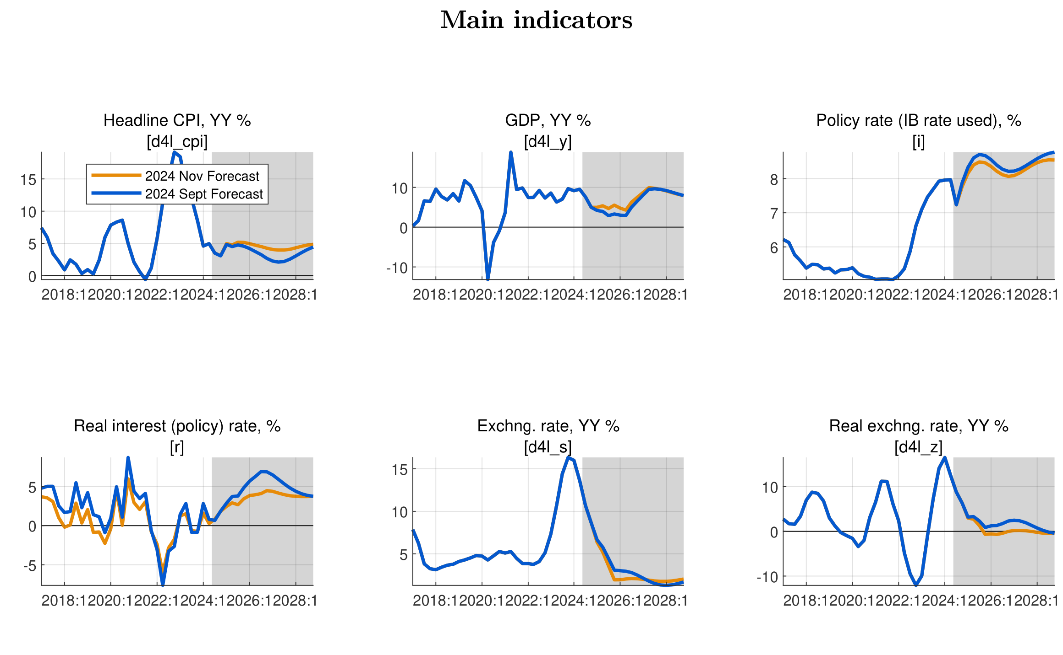
VIII. Model revision—Effect of recalibration
Main indicators
Nov 2024 vs. Sept 2023 forecasts
Effect of parameter recalibration (Incl. IB rate response to inflation and output gap, UIP and Core CPI persistence)
More responsive policy and real interest rates on inflation (recalibrated reaction of IR on inflation)
A less overvalued Exchange Rate (ER)—A less ER depreciation
CPI turning to target and more accelerated post-2026.
Higher GDP growth due to less tight monetary policy.

Slide 27
VI. Inputs for intMF projections & discussions (template)
QMFM forecast is an independent assessment of macro-outlook—incl. interaction of macro policies. Its demand-driven approach complements the mainly supply-driven intMF projection
Real GDP: contractionary impact of fiscal deficit reduction and RIR increase in 2025-26 suggest downward adjustment of GDP growth from intMF sum of sectoral growth rates:
for intMF consider: GDP growth around 6% in 2025-26 before catch up to 8-9% in 2027-28
CPI: the negative impact on demand of the restrictive policies—more than offsetting price-increasing effect of fast NER depreciation—should lead to subdued inflation in 2025-26:
for intMF consider: CPI rate below 5% in 2025-26
Private demand: restrictive policies slow down private investment/consumption growth, to consider in intMF where investment growth is a guess and consumption residual:
for intMF consider: real consumption growth much below trend in 2025-26
real investment growth 5-6% in 2025-26
Imports G&S: following domestic demand and GDP—compounded by recent strong RER depreciation--real imports growth is forecast to dip much below trend in 2025-26: :
for intMF consider: real import growth +6% in 2025-26 as check against BoP’s sum of import lines
Notes:
See Output gap and Fiscal Impulse in last Chart

Slide 28
VI. Inputs for intMF projections & discussions (cont’d) (template)
Exports G&S: export growth is forecast to return to trend after dip in 2024, helped by recent strong RER depreciation:
for intMF consider: real export growth +10% in 2025-26 as check against BoP’s sum of export lines
Fiscal path: 2024/25─2025/26 reflects PCI fiscal program targets (in % GDP). But the forecast from 2026/27 reflects premise that the deficit and its components be allowed to move gradually to their sustainable levels (for deficit 7.5% of GDP, before grants of 2.5%):
for intMF consider: return to sustainable deficit (and components) of 7.5% of GDP from 2026/27
Exchange rate: the forecast reflects NBR’s rule of return to ER path that first corrects for RER overvaluation, then for inflation differential with trading partners (+3% py). The 2022-23 RER overvaluation (due to the inflation surge) was more than corrected in 2024:
for intMF consider: much smaller NER depreciation rate than in 2023-24, i.e. of some 2% p.y.
Real interest rate: forecast reflects a rise back to ‘normal’ for real policy (IB) and lending rates (+8% points above real IB) as NBR raised interest rates and inflation plunged in 2024. The RIR rise has contributed to demand restraint in 2024-26. Beyond 2026, RIR reflect higher world RIR (1.5% from 2026, compared to 0% in 2023).
for intMF consider: how does the forecast RIR affect real private domestic demand?
Notes:
See Output gap and Fiscal Impulse in last Chart

Slide 29
THANK YOU

Slide 30
X. Data issues and requests & suggestions
Model/Outlook data issues to be addressed
intMF – fiscal: accurate govt demand for G&S, more timely and reliable Q data, timely Q treasury plan
– debt: timely & complete Q data (showing IMF separately) and projections integrated into intMF
NA/NISR – discrepancies/anomalies Govt consumption, investment, inventories, final demand deflators
NBR – more timely Q BoP data, as input for models and intMF
NBR-FPAS results, analysis of potential output, international interest rates (GPM)
WEOGAS & GEE in right format– timely sharing by IMF staff, QoQ projection instead of YoY
timely data reconciliation and iterative comparison of forecast results from various tools
input for intMF well before each Review and each quarter
Notes:
MINECOFIN can have a different assessment of path and impact of monetary and ER policies than NBR, just as NBR can have a different assessment of path and impact of fiscal policies.

Slide 31
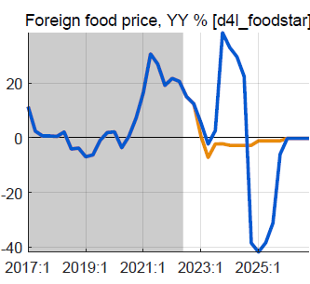
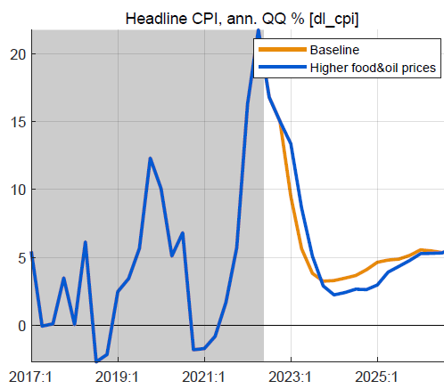
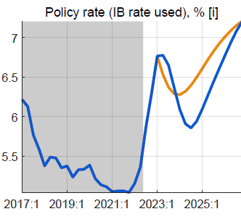
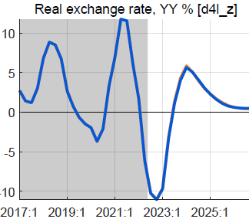
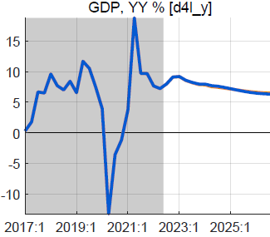
XI. Alternative scenario: higher foreign food/oil prices (2023-24)
Higher-than-WEO foreign food and oil prices in 2023-24
foreign food and oil prices on average 25% higher than BL
with peak around end-2023, return to WEO levels from 2025
no change in fiscal policy
Results in higher headline CPI, little or no effect on output
headline CPI temporarily higher, reflecting food/oil import shares
small response policy rate, reversed fast as expected inflation drops
small positive effect on demand of lower RIR
mostly offset by negative effect of slightly more appreciated RER
overall effect on GDP is very small, less than 0.2%

Slide 32
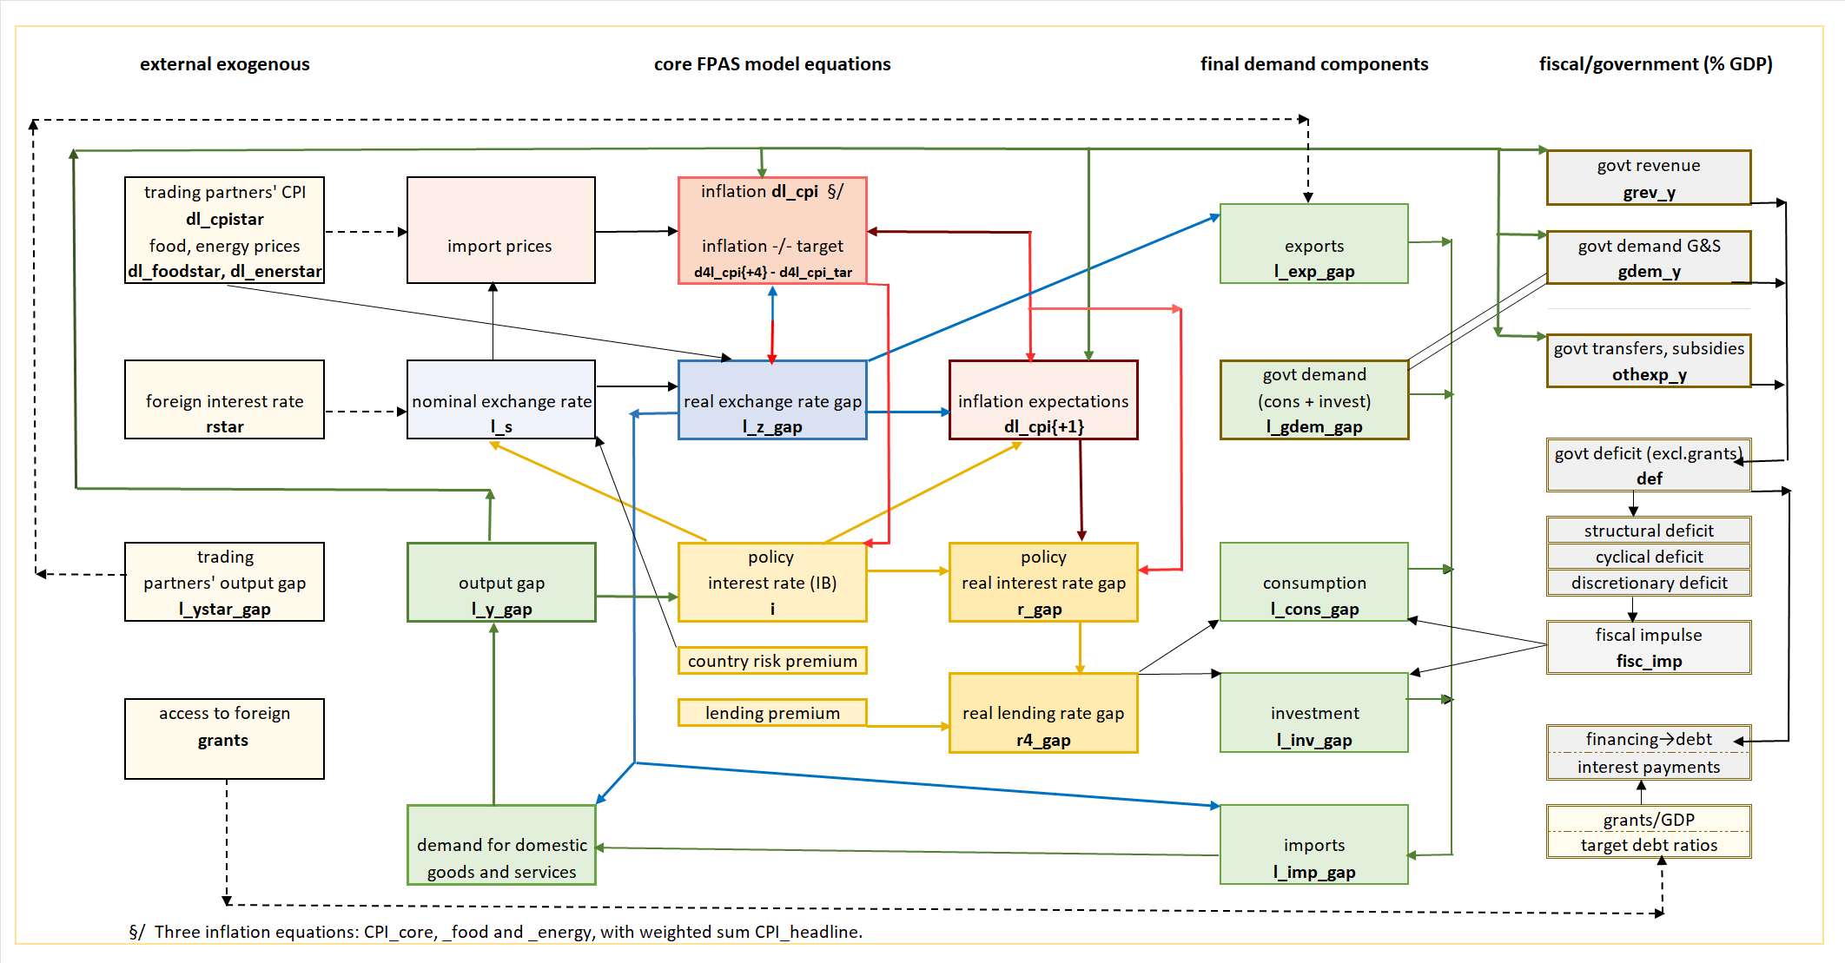
VIII. QMFM: main relationships and transmission mechanisms

